Slide 1
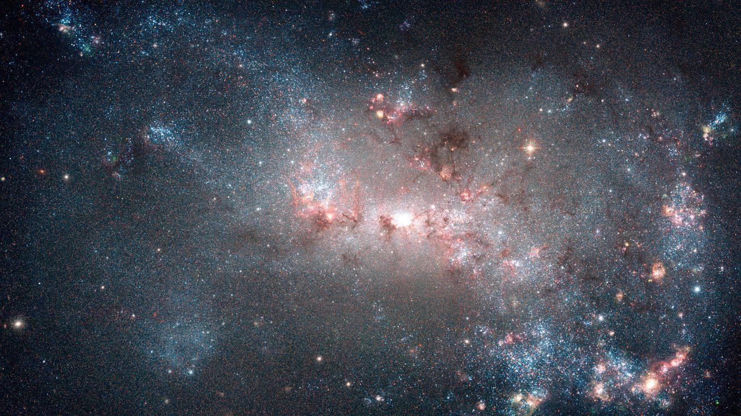
Laser Interferometers' Calibration Errors In Gravitational Waves From Core Collapse Supernovae
Collaborators: B. Ratto, A. Gribovsky, A. Mauricio, M. Szczepanczyk & M. Zanolin

Slide 2
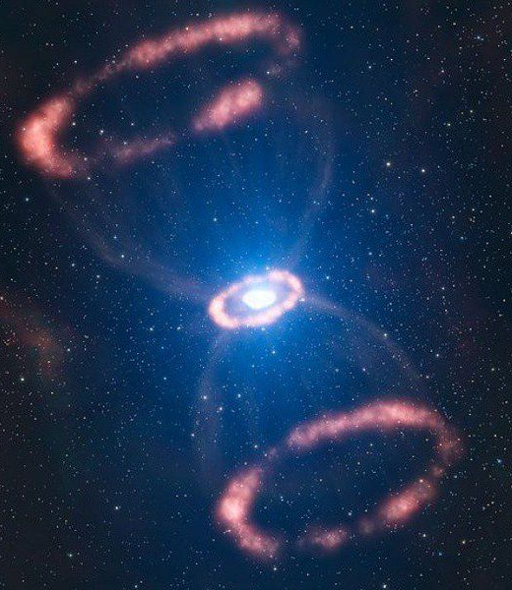
The goal of this project is to quantify the impact of calibration errors on reconstructed gravitational waves from core collapse supernovae which are detected by using laser interferometers
Results from this study can also impact the reconstruction of astrophysical parameters including possible violations within General Relativity
Introducing Calibration Error
Idiosyncrasies of Applying Calibration Errors for Supernovae
Relevant quantities computed by the coherent wave-burst algorithms and matched filters

Slide 3
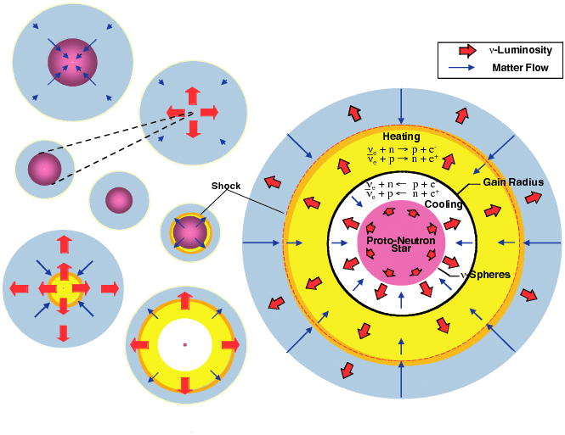
What are Core Collapse Supernova?

Slide 4
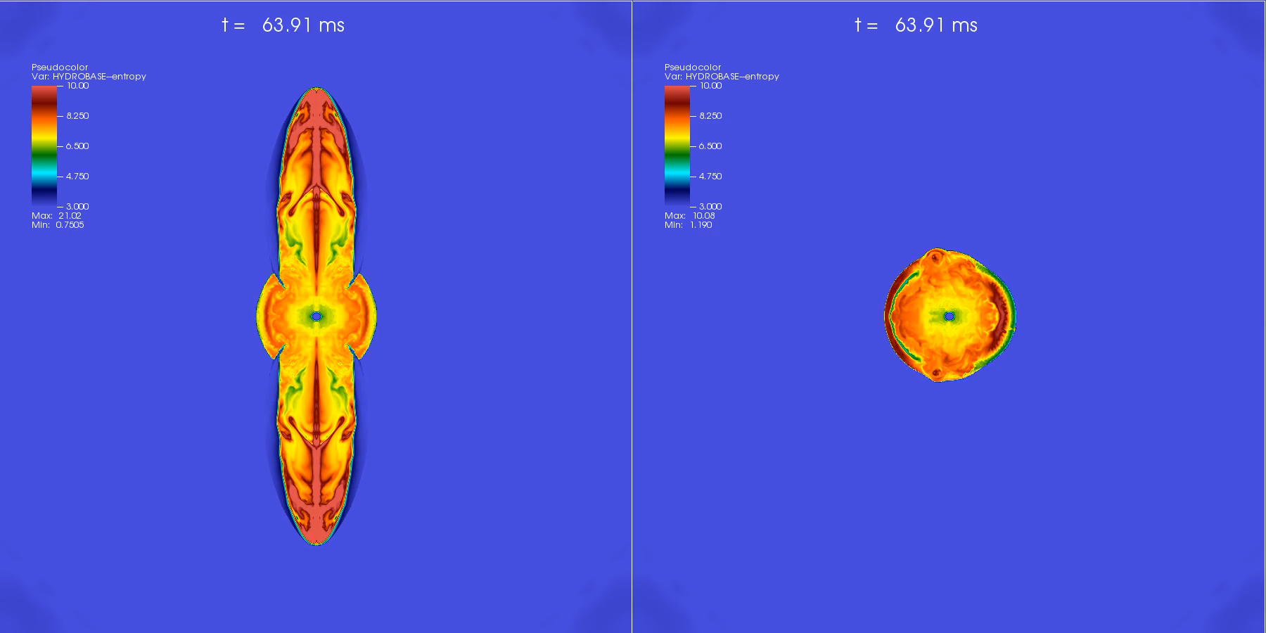
2D Simulation | 3D Simulation

Slide 5
Calibration Flowchart
cWB Pipeline
LIGO Raw Output: Measured as an Optical Intensity I(t)
Calibration
Space-Time Strain h(t)
Matched Filtering
NASA Space Grant Symposium 2020
Notes:
Here we visualize the steps taken in order to process the raw output from LIGO; data from the instrument is taken, calibrated in order to take into account the errors that may be present in the instrument or any environment based conditions.
The light intensity is convoluted with a time dependent calibration filter to produce the strain data h(t)
Once the strain of the signal is produced, the coherent wave burst pipeline and/or matched filtering techniques can be used to extract gravitational wave information

Slide 6
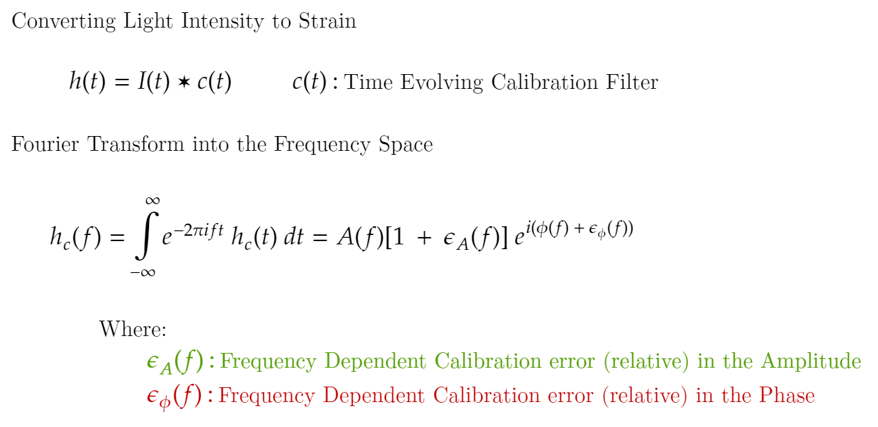
Calibration Errors
NASA Space Grant Symposium 2020
Notes:
My study involves taking a look at the impact calibration errors have when processing the signal from LIGO
By taking our strain data from the time domain and passing it into the frequency space using a Fourier Transform we are then able to distorted the signal in both frequency phase and amplitude

Slide 7
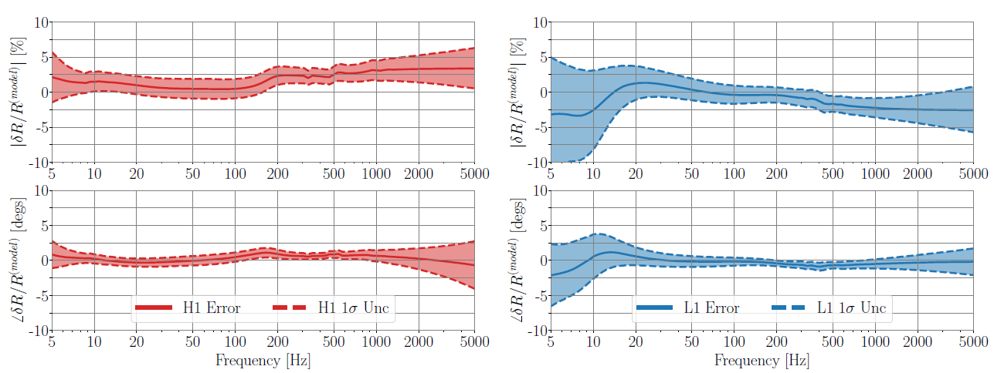
Calibration Error Bounds
Hanford, WA
Livingston, LA
Amplitude
Phase
Total Calibration Error and Uncertainty Budget at the time of GW170104.
NASA Space Grant Symposium 2020

Slide 8
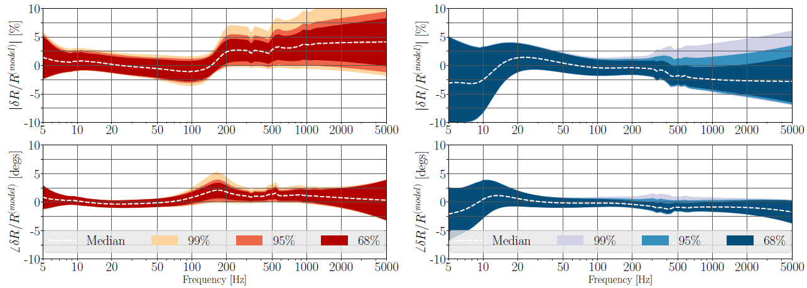
Calibration Error Bounds
Hanford, WA
Livingston, LA
Amplitude
Phase
Total Calibration Uncertainty Percentiles for Observing Run Two.
The percentiles are created for all of O2 data from November 30, 2016 to August 25th, 2017.
NASA Space Grant Symposium 2020

Slide 9
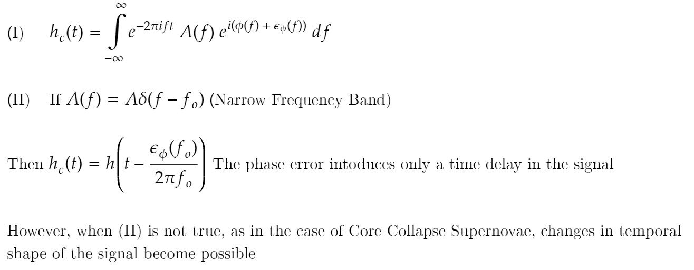
Role of Phase Calibration Errors
NASA Space Grant Symposium 2020

Slide 10
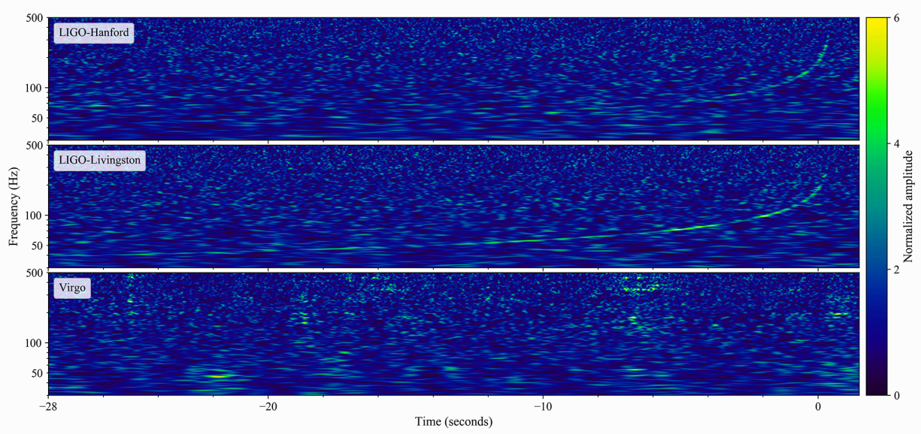
Binary Neutron Star Merger
NASA Space Grant Symposium 2020

Slide 11
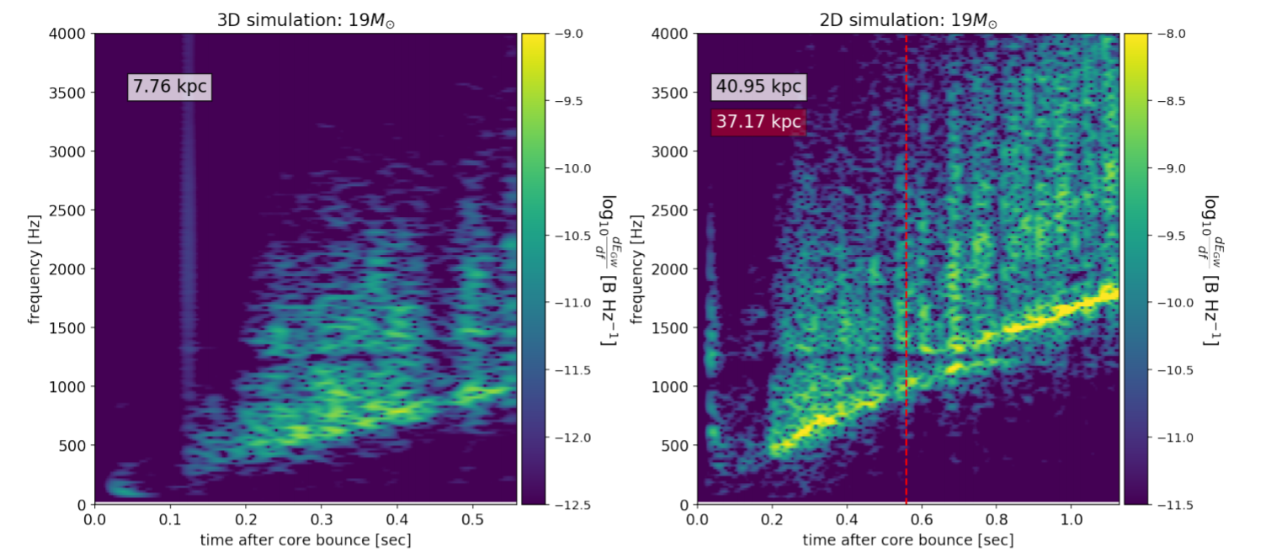
Supernova Simulated Event
NASA Space Grant Symposium 2020

Slide 12
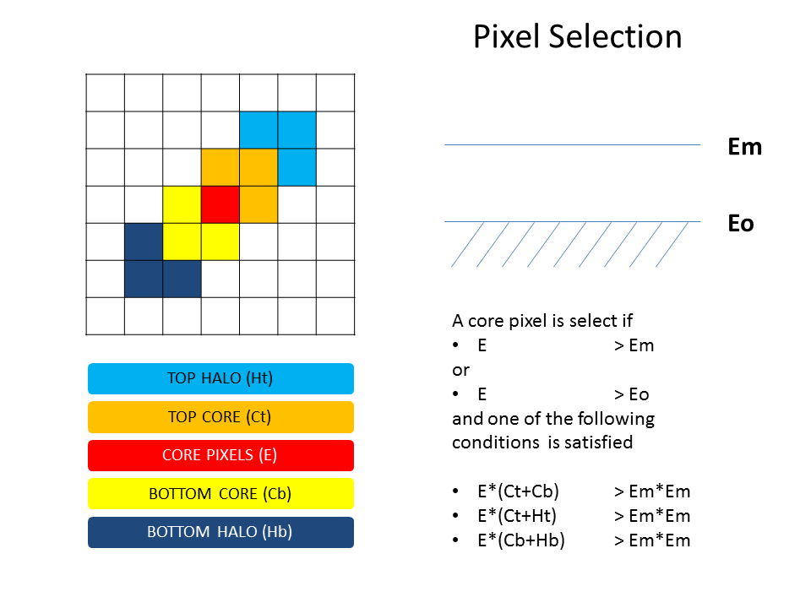
Coherent Wave Burst (cWB)
Process Description:
cWB collects incoming data and constrains it to the maximum likelihood conditions under one coherent statistic.
cWB’s detections are dependent on the total signal to noise (SNR) ratio of the GW signal detected in the network.
NASA Space Grant Symposium 2020

Slide 13
Coherent Wave Burst (cWB)
Post-Production:
We are going to produce Gravitational Waveforms with realistic calibration errors and inject them into LIGO noise allowing us to produce the following quantities:
Signal-to-Noise Ratios from cWB
Cross Correlation Coefficient from cWB
Fitting factor between the reconstructed and injected waveform from cWB
NASA Space Grant Symposium 2020

Slide 14
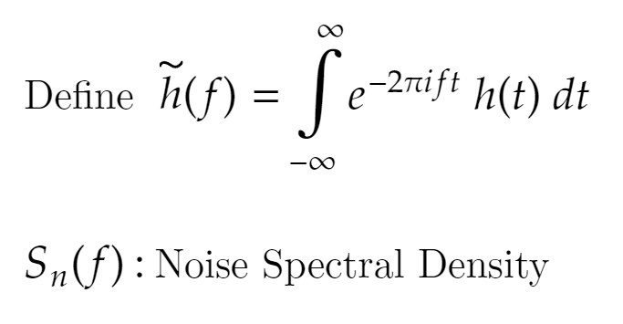
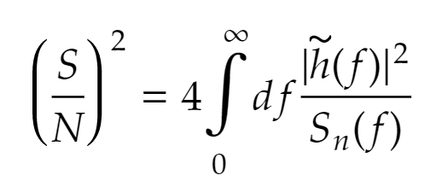
Signal-to-Noise Ratio (SNR)
The signal-to-noise ratio (SNR) indicates how much of the gravitational wave signal is present within a given noise spectral density; ergo a higher SNR indicates a larger probability of a signal being present within a set of data
NASA Space Grant Symposium 2020

Slide 15
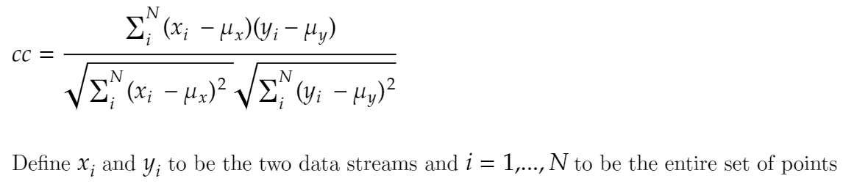
Cross Correlation Coefficient
The cross correlation coefficient (cc) lies between -1 and 1, inclusive; a value of 1 means that the two series are completely correlated, while a value of -1 means that the series are completely negatively correlated. A value near zero means that the series are uncorrelated.
NASA Space Grant Symposium 2020

Slide 16
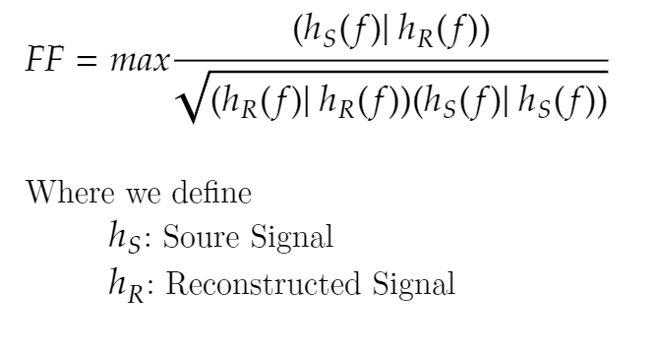
Fitting Factor
The fitting factor (FF) indicated how well an injected distorted waveform matches the reconstructed waveform cWB produces. The FF is a scalar measure ranging from 0 to 1, such a process takes into account spectral noise density.
NASA Space Grant Symposium 2020

Slide 17
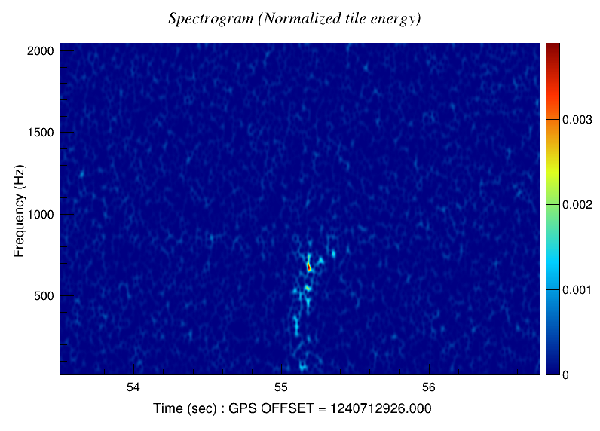
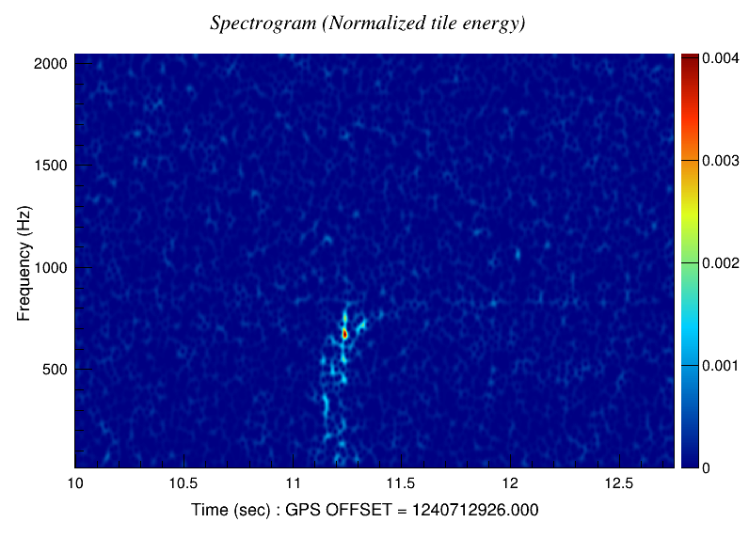
Spectrogram
Undistorted Simulated
10% Amplitude & Phase Error
NASA Space Grant Symposium 2020

Slide 18
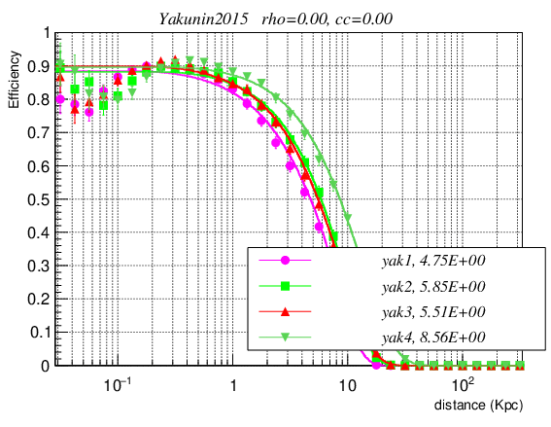
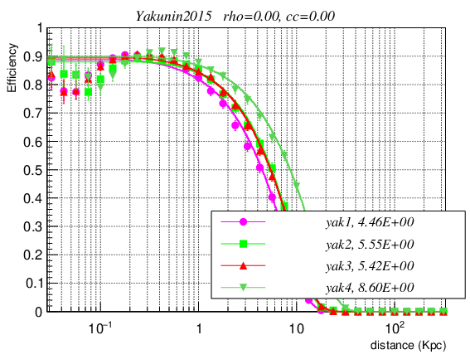
Efficiency vs. Distance
Undistorted Simulated
10% Amplitude & Phase Error
NASA Space Grant Symposium 2020

Slide 19
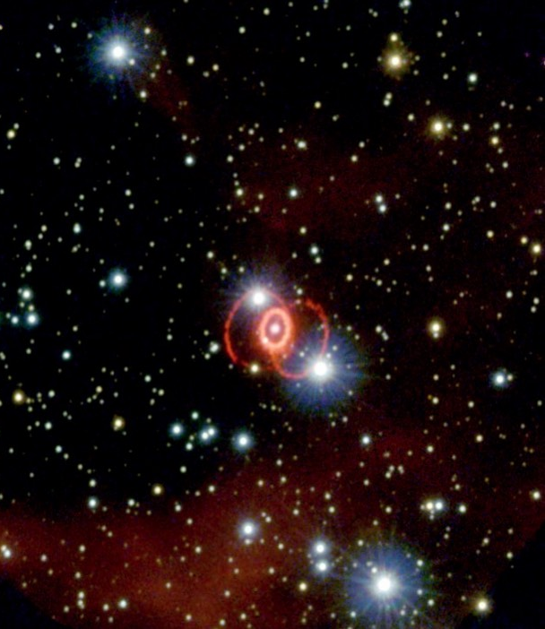
Questions?
The goal of this project is to quantify the impact of calibration errors on reconstructed gravitational waves from core collapse supernovae which are detected by using laser interferometers
Contact information:
Brad Ratto
rattob@my.erau.edu

